Slide 1
Linear Regression BY Piyush pathak
Freelancer Data Scientist
Ex- OPPO TEAM LEADER (Sales strategy and Forecasting) From:- Feb/2017 – June/2019
Linkedin:- https://www.linkedin.com/in/piyushpathak03/

Slide 2
Agenda for Today’s Session
WHAT IS REGRESSION
We will understand the Regression and will move onto the types.
REGRESSION DIAGNOSTICS
Lets find what best works with Linear Regression
UNDERSTANDING LINEAR REGRESSION ALGORITHM ASSUMPTIONS
Lets Look into the Assumptions & Violations

Slide 3
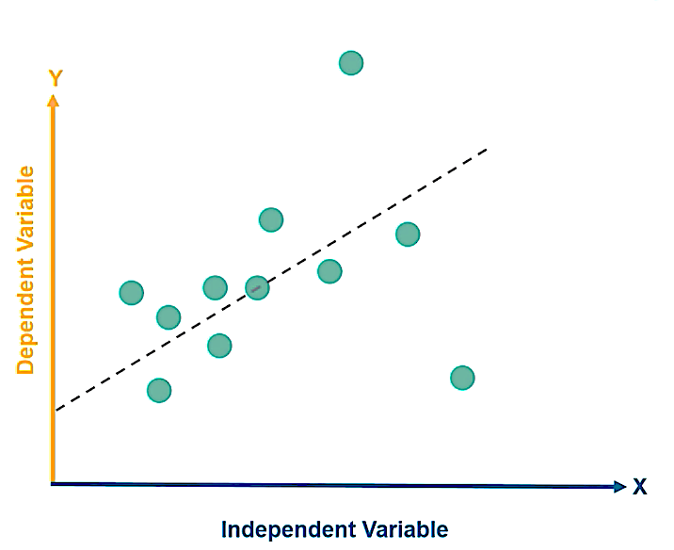
Understanding Linear Regression Algorithma
Intro
Establishes a relationship between the Independent & Dependent Variables.
Examples of Independent & Dependent Variables:-
x is Rainfall and y is Crop Yield
x is Advertising Expense and y is Sales
x is sales of goods and y is GDP
Here x is Independent Variable & Y is Dependent Variable
How it Works
Regression analysis is used to understand which among the Independent Variables are related to Dependent Variables.
It attempts to model relationship between two variables by fitting a line called Linear Regression Line.
The case of Single variable is called Simple Linear Regression where as the case of Multiple Independent Variables, it is called Multiple Linear Regression

Slide 4
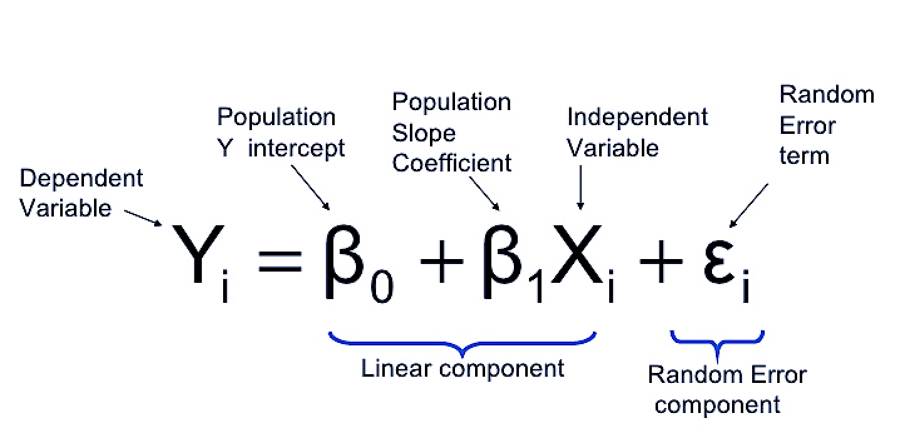
Linear Regression Equation
Slope/Gradient
y = mx + c
Y Intercept

Slide 5
Applications
Sales Prediction
Country GDP Prediction.
Cricket Scores Prediction
Grades Predictions and many more .
THANKS

